Slide 1
IDEA DETAILS :
Technology Bucket : Software – Mobile App Development
Category – Education
Problem Statement – Lack of Learner Motivation and Engagement
Team Name – Blue Crusaders
Team Leader Name – Sourabh Santhosh Kamble
College Name – K S Institute of Technology

Slide 2
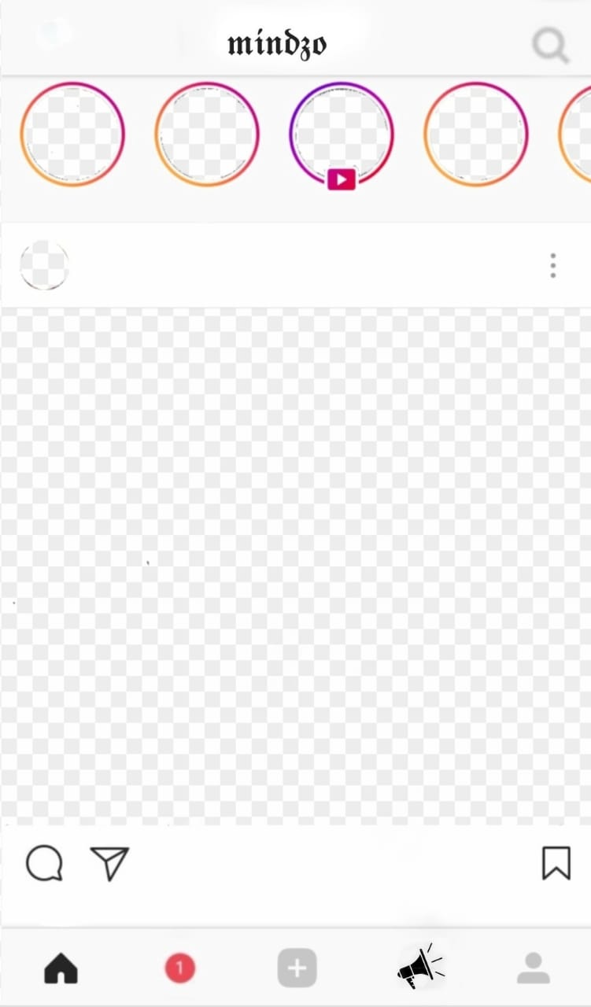
SOLUTION :
96%
The mobile application allows both the student and teacher to have a profile.
The result of outcome is shown in prior to the student to gain motivation.
Contents Title
Students would be permitted to post in their profile short / long animated videos of the concepts taught to gain popularity.
Faculties post important announcements as stories in one shot.
Students can build funny acronyms of the difficult concepts and post as their stories which makes learning interesting and fun.
Students are allowed to create memes for better understanding of concepts and gain popularity.
Students are rewarded for their work observed in their profile.
Brainstorming sessions, quizzes and polls are incorporated.

Slide 3
This mobile application is used by both teachers and students.
It encourages the students to showcase their perspective towards learning through their posts and educational videos.
User friendly platform to enhance student’s talent and creativity skills required for the industry.
Develops interest and involvement not only by the students but also the fellow ones.
As students show interest towards posting stories , the idea of this makes learning fun.
Various quizzes , brainstorming sessions and rewards provided at the end motivates the student.
Showcasing the result of outcome in prior encourages the student and makes him/her involved.
The idea of creating educational memes makes the student to enhance the creativity and keeps them engaged.
SHOW STOPPERS :
USE CASES :
This mobile application will be available in regional languages which will encourage the rural students and teachers to make the best use of it.
Makes online learning much more interesting and motivates the students to dive into the field interested.
Enables educators to get a higher degree of coverage to communicate the message in a consistent way for their target audience.
Unknown talents of the students come out.
No investment is required.
The application is user-friendly and flexible.
The application's environment will overcome the problem of lack of engagement and motivation.
FUTURE IMPLEMENTATIONS :
TECHNOLOGY STACK :
Enabling voice-chat with faculties.
Teacher-student interaction through video conferencing.
Creating memes through the application itself.
React-native for mobile application
Mysql database
Java for backend

Slide 4
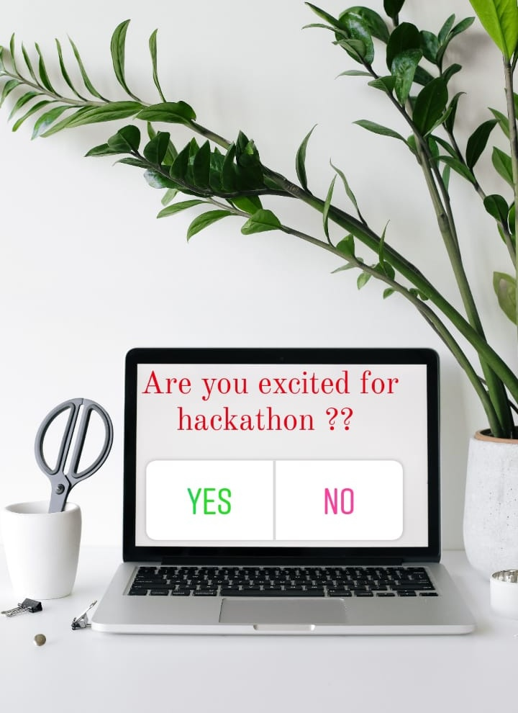
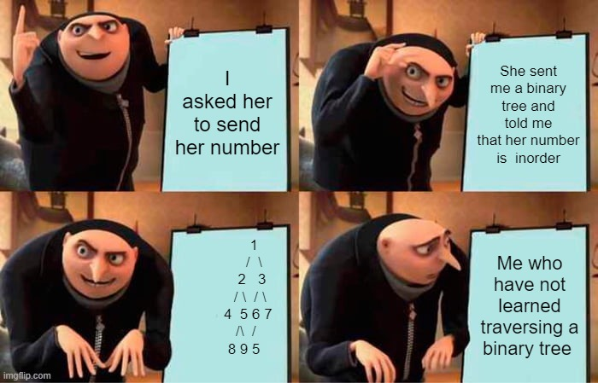
SOME CREATIVES

Slide 5
TEAM PROFILE :
Team Objective :
The purpose of this is to develop a mobile application that motivates and inculcates rapid learning abilities by encouraging the students.
Sujay GS
Sujay GS
Sourabh Santosh Kamble
R.Pratiksha
Yogita Raikar

